Slide 1
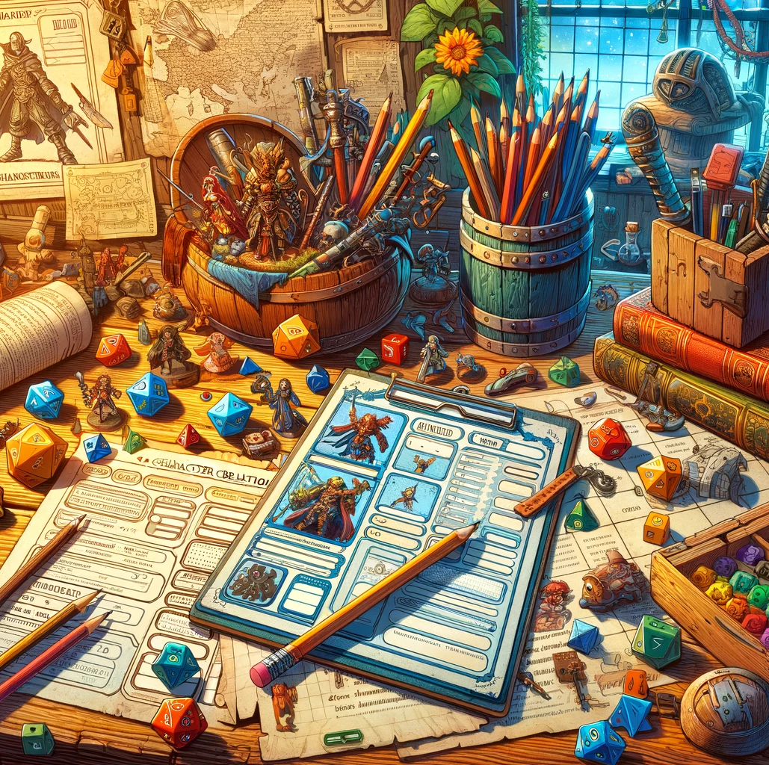
Sanctum TTRPG App
Johnathan Partridge

Slide 2
The Sanctum Tabletop Roleplaying game
Unreleased dark low-fantasy TTRPG with a punishing combat system.
Complex rules
Armor Layering
Derived Statistics
Encumbrance
Memory

Slide 3
Qualifications
Multiple DOTNET Projects
CIS 560 Project
Developed DOTNET applications at internships

Slide 4
Use Cases
Cloud Character Sheet Storage
Character Sheet Sharing
Live Character Sheet Modification
User Creation
User Validation

Slide 5
Minimum viable product requirements
Ability to create and delete character sheets
Real-time synchronization between basic character sheet edits
User registration and logging in
User password encryption
Username appropriateness filter
Grant user access using JWT schema

Slide 6
Version 1.0 requirements
MVP hosted on Azure
Ability to share character sheets with other users
Responsive and user-friendly user interface
Need to have more view sizes than just widescreen
Automatic character sheet calculations
Ability to roll character stats
Ability to inflict status effects on a character that effect stats
User email verification
Useful character journal
Sections for events, allies/adversaries, companions, and other general notes

Slide 7
Version 2.0+ requirements
Character creation wizard
Run through all the steps of the character creation process.
Ability to create and manage campaigns
Add users to campaigns, and add their characters to it
Chat service
Give game master access to modify/view user’s relevant characters
Live battle map

Slide 8
Design & Implementation

Slide 9
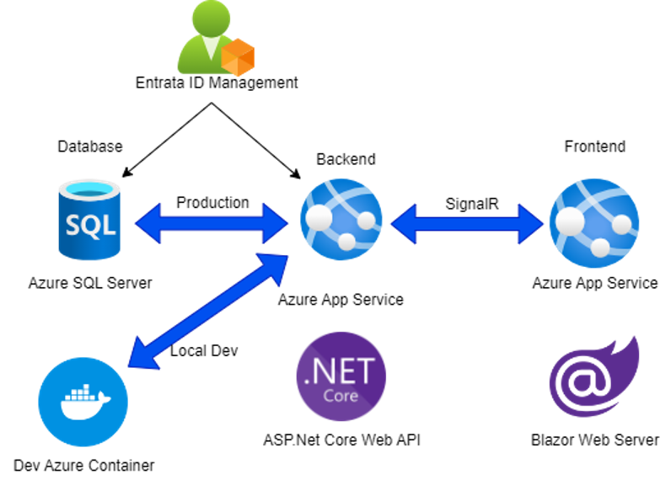
Tech Stack

Slide 10
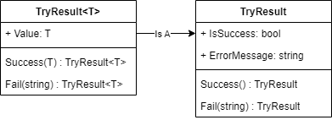
TryREsult<T>

Slide 11
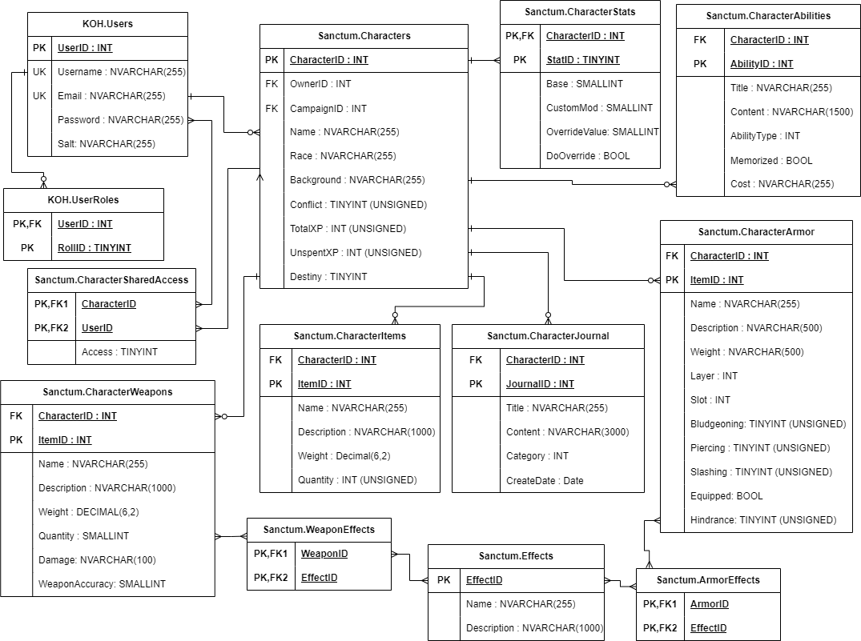
Database erd

Slide 12
Main algorithmic complexity
Modify by Path Algorithm
Async Locking
Real-time synchronization
Profanity Guard
User Password encryption
Armor Layering
Responsive User Interface

Slide 13
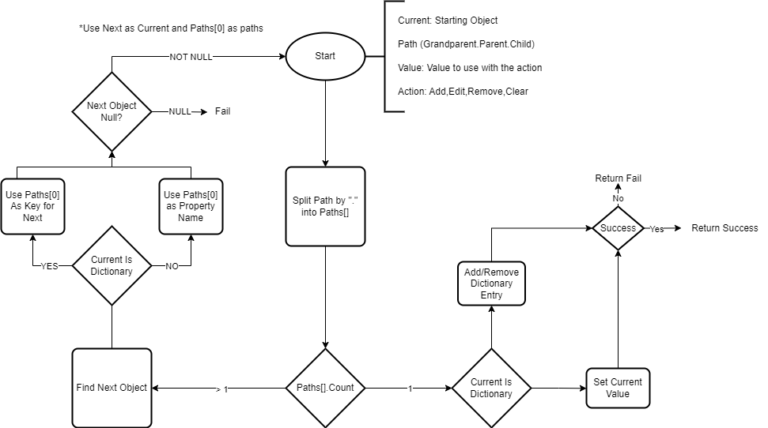
Modify By Path algorithm

Slide 14
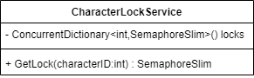
Async locking
How to use
Use GetLock() to Get the Semaphore associated with the CharacterID.
Use the Semaphore.WaitAsync() to wait for access to the CharacterID.
When finished use Semaphore.Release()
This process allows the async locking of actions on a Character by locking access to the CharacterID.

Slide 15
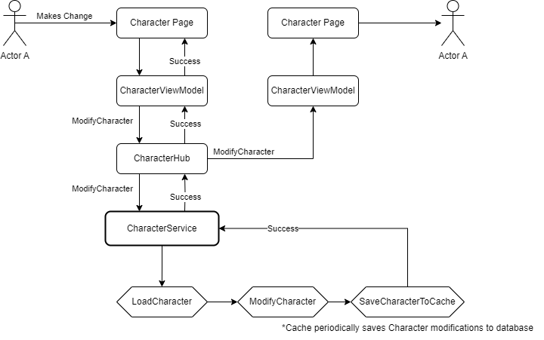
Real-time Synchronization

Slide 16
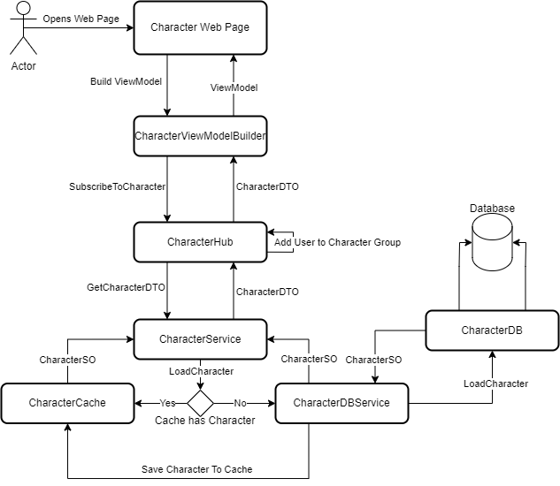
Setup

Slide 17
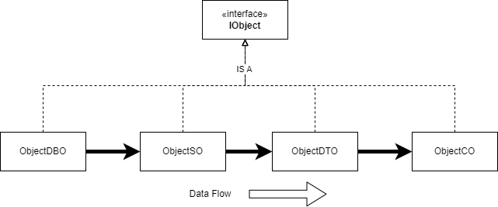
Data Flow

Slide 18
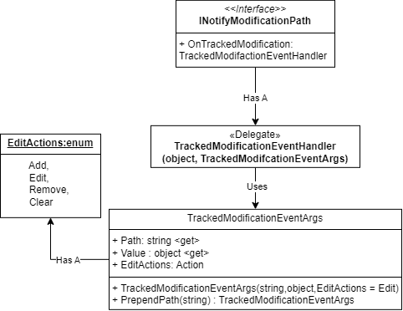
INOTIFYTRACKED MODIFICATION

Slide 19
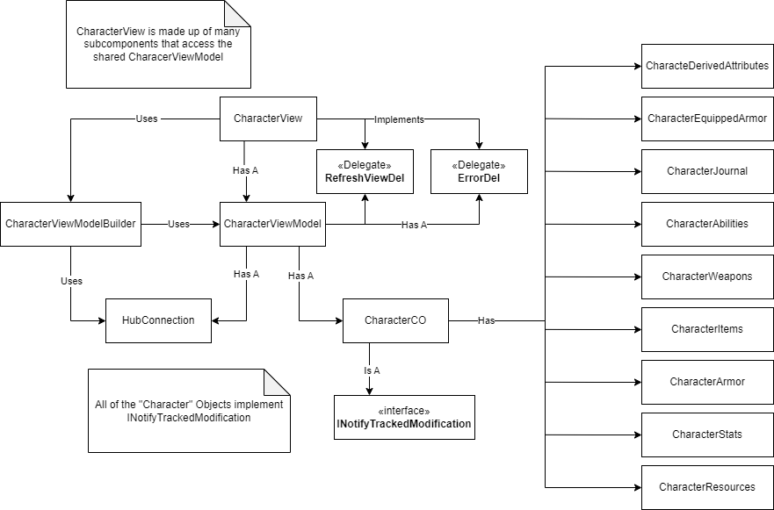
Frontend

Slide 20
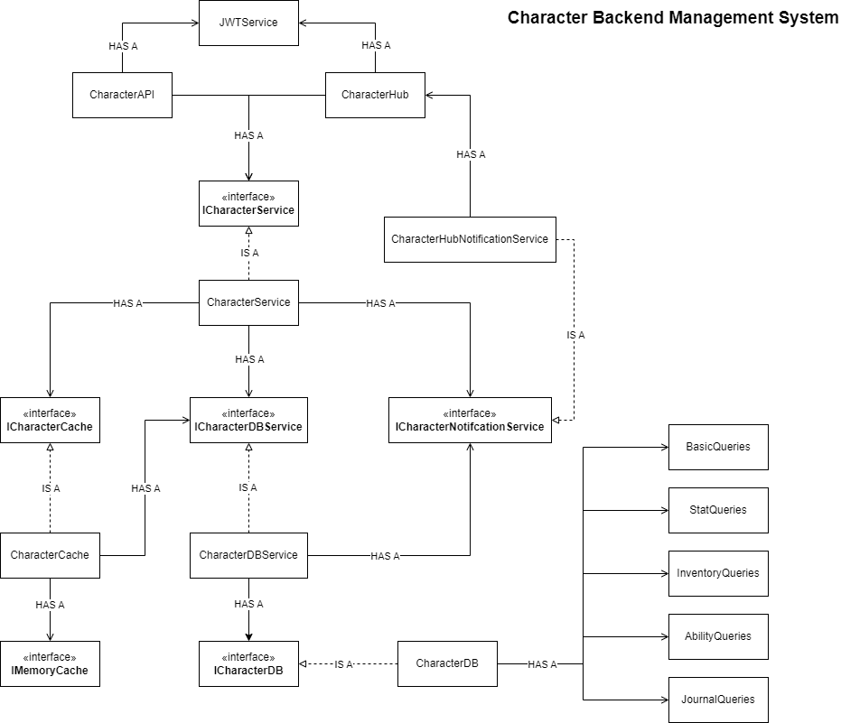
Backend

Slide 21
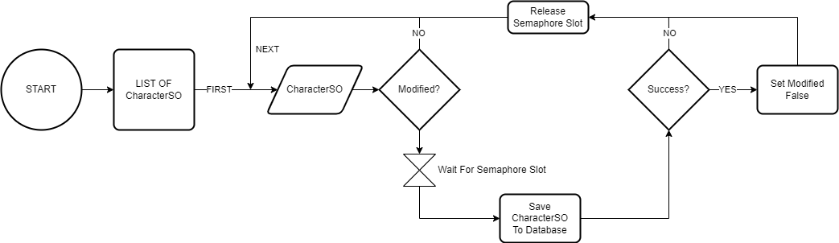
Character caching Background service

Slide 22
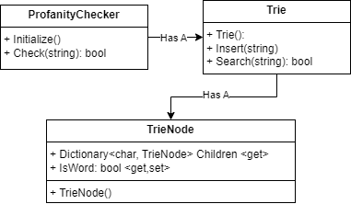
Profanity Guard

Slide 23
Armor Layering
Problem: A piece of armor can cover X parts of the body, and takes up a Armor Layer (Light,Medium,Heavy)
For each slot you can only have one of each type of layer.
There are a total of 12 slots
Solution:
We can store armor slots in the binary representation of an integer.
0000 0000 0000 0000
Each bit represents whether a piece of armor takes up the corresponding spot.
For example:
0000 0000 0000 0011
Would represent an Armor Piece that covers the head and neck.

Slide 24
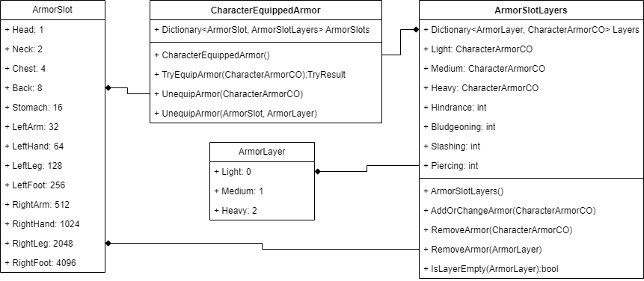
Armor Layering DIAGRAM

Slide 25
Password encryption
Creation
Generate a random hex string as a salt.
Store this salt associated with the user.
Use the salt to encrypt password with builtin KeyDeriviation with HMACSHA256 encryption with 10000 iterations.
Save salted password
Usage
Load salt and salted password
Encrypt given password with salt.
Check that salted password and encrypted password are same

Slide 26
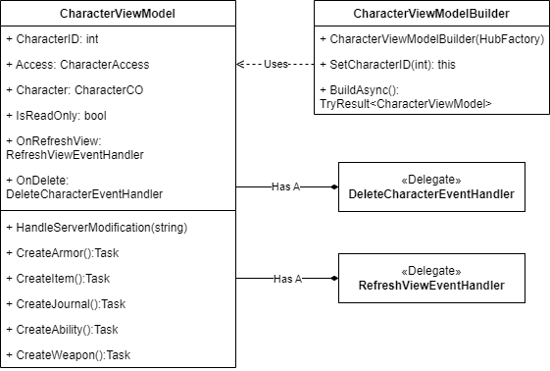
User Interface

Slide 27
Testing

Slide 28
Unit Testing
Currently only around 40 unit tests to test basic functionality.
Database operations
TrackedModification events
ModificationByPath

Slide 29
Live Functionality Testing
Setup Local/Production launch settings to test against different aspects.
Local Webpage against the live backend, etc.

Slide 30
Deployment

Slide 31
Web app Deployment
https://knightsofherman.azurewebsites.net

Slide 32
Live DEMO

Slide 33
Demonstrations
User Account Registration
User Login
Character Creation
Sharing Character
Live Updates and Character Sheet Overview

Slide 34
What’s Next?

Slide 35
Future Work
Create a UI testing document
Increase the amount of unit testing
Load testing
Version 1.0 Features
Status Effects
Dice Rolling
Version 2.0 Features
Campaign Manager with Battlemaps
Wiki
Rules
Items
Abilities
Integration with character sheet

Slide 36
Conclusion & Lessons Learned
Need to increase the levels of abstraction for ease of testing
Start with frontend instead of backend
Start with Test-Driven development
Utilize LINQ from the start
Make things simple and easy to replicate
First, I had all 70+ stats in a single table entry, but then moved them to a table with ids per stat.

Slide 37
Questions?

